Slide 1

Project Title –SEASONAL AGRICULTURE PERFORMANCE ANALYSIS
Khushi Kumari
Bharati Vidyapeeth Deemed to be University College of Engineering
AICTE STU ID : STU6a6503d589ac01785005013

Slide 2

PROBLEM STATEMENT
(Agricultural activities are influenced by seasonal variations in environmental conditions, farming practices, resource availability and market conditions. As a result, agricultural performance may differ from one season to another. However, raw agricultural data does not clearly explain how agricultural performance changes across seasons or what patterns can be observed in different seasonal conditions. The problem is to analyze the given agricultural dataset and investigate seasonal differences in agricultural performance by identifying meaningful patterns, trends, relationships and variations within the available data.

Slide 3
Project Description
This project analyzes agricultural data across different seasons, crops and geographical regions.
Analysis Areas
Seasonal performance analysis
Environmental condition analysis
Crop-wise and season-wise comparison
Irrigation and resource usage
Economic performance
Disease & pest risk
State-wise performance
Statistical analysis
Outlier and unusual pattern detection
Main Approach
Season → Environment → Resources → Crop Performance → Economics → Recommendations
The objective is to identify meaningful patterns, relationships and differences in agricultural performance.

Slide 4

WHO ARE THE END USERS?
Farmer- understand crop and seasonal performance.
Agricultural Departments – support planning and decision-making.
Data Analysts – analyze agricultural trends and relationships.
Agricultural Researchers – study environmental and crop patterns.
Resource Managers – evaluate water and fertilizer usage.
Agribusinesses – understand production and economic performance.

Slide 5

Technology Used
Programming Language
Python
Libraries
Pandas – Data manipulation and analysis
NumPy – Numerical operations
Matplotlib – Data visualization
Seaborn – Statistical visualization
SciPy – Statistical testing and ANOVA
Platform
Google Colab
Jupyter Notebook
Dataset
CSV format

Slide 6
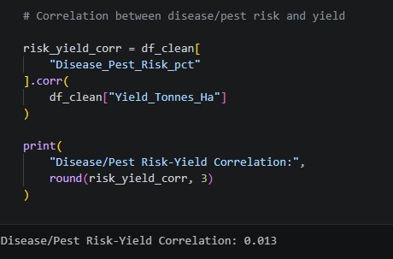
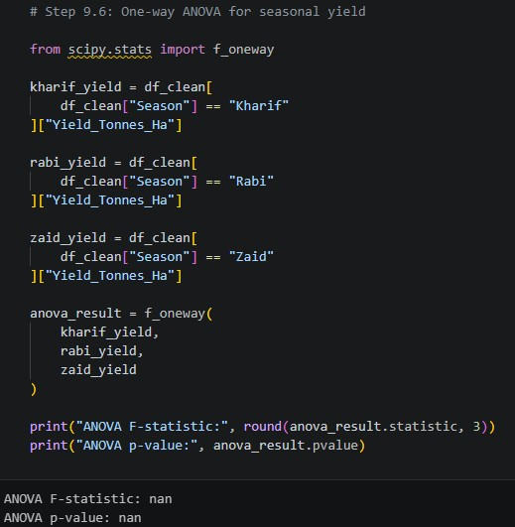
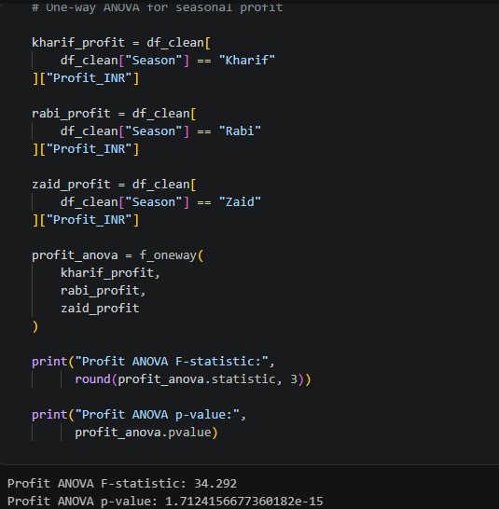
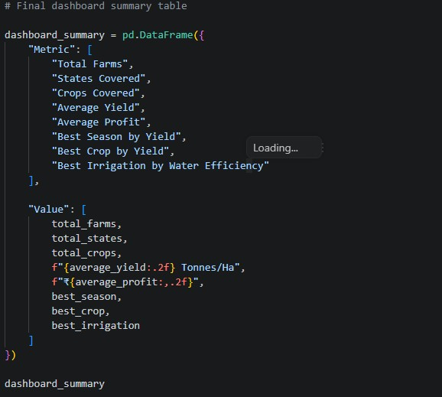
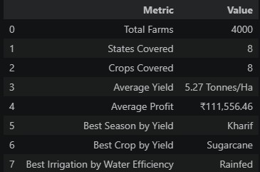
RESULTS

Slide 7
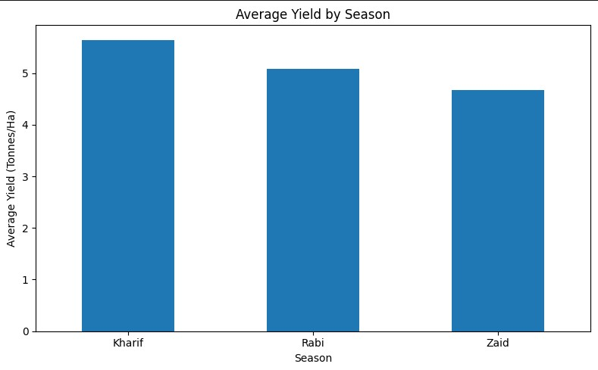
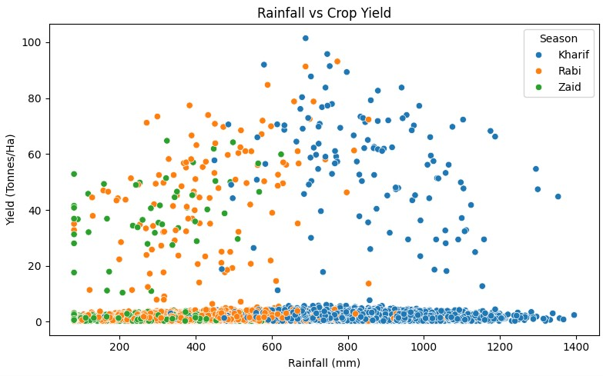
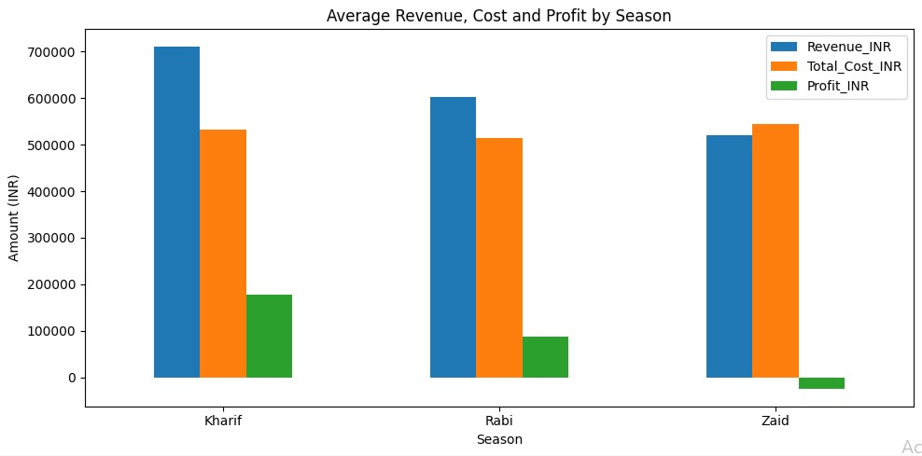
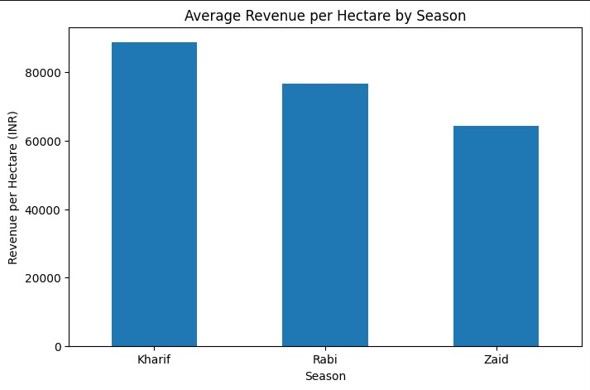
RESULTS

Slide 8
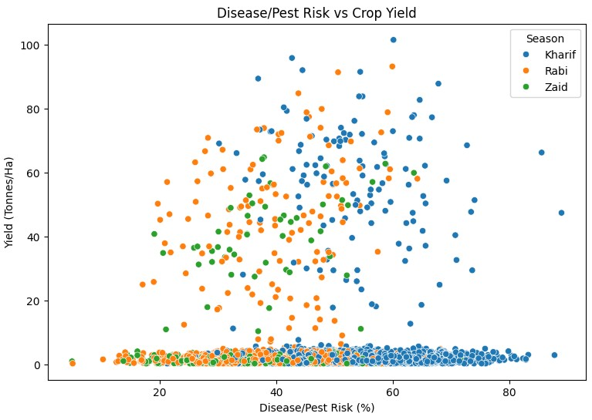
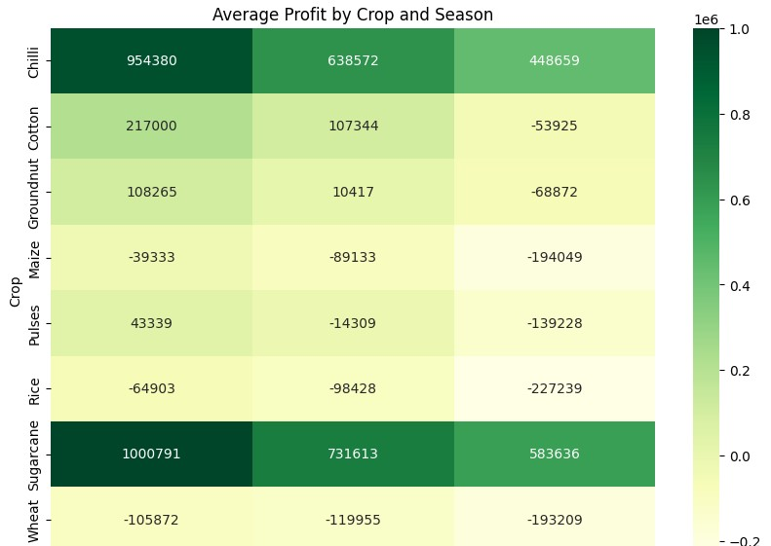
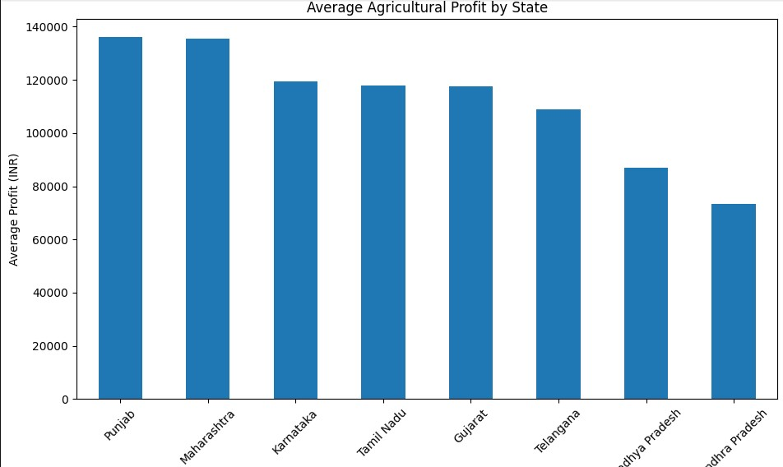
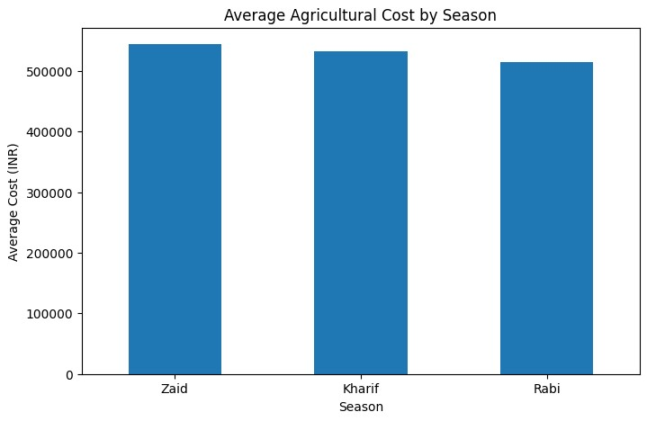
RESULTS

Slide 9
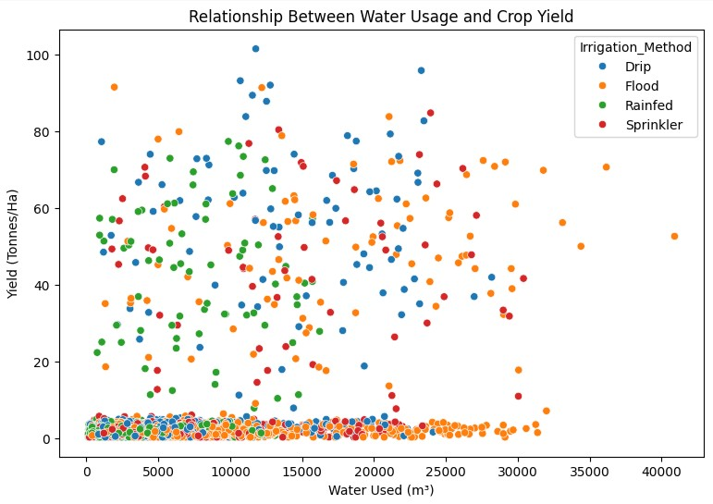
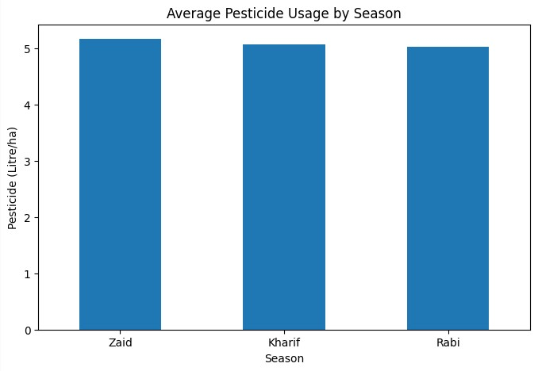
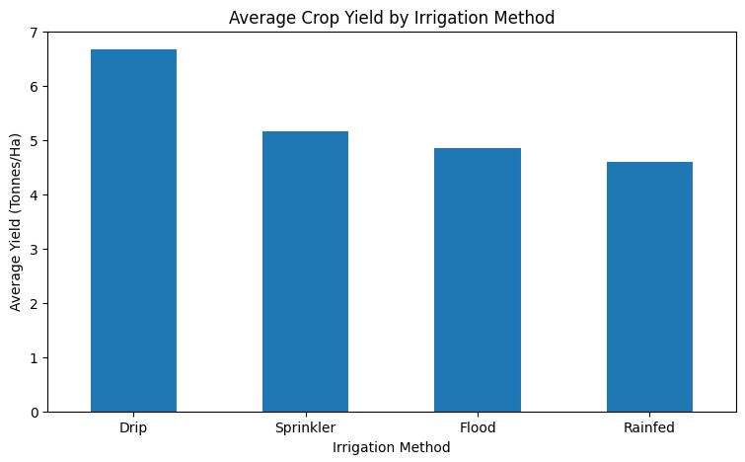
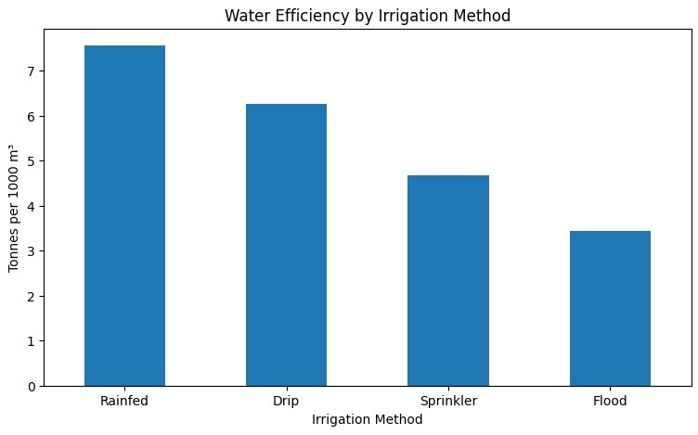
RESULTS

Slide 10
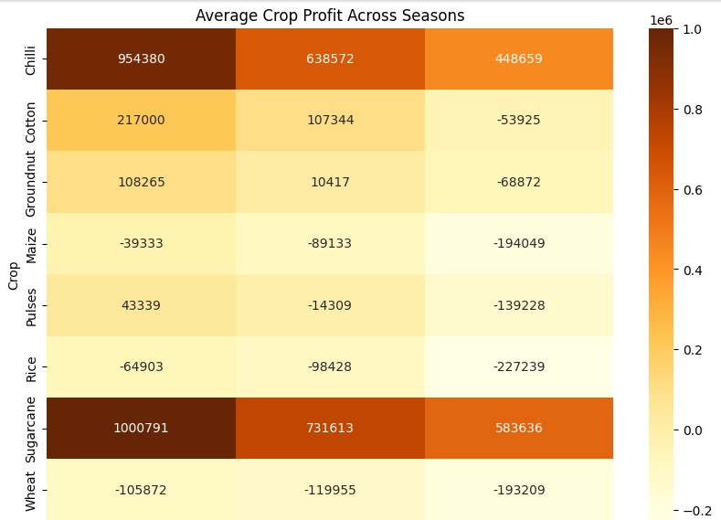
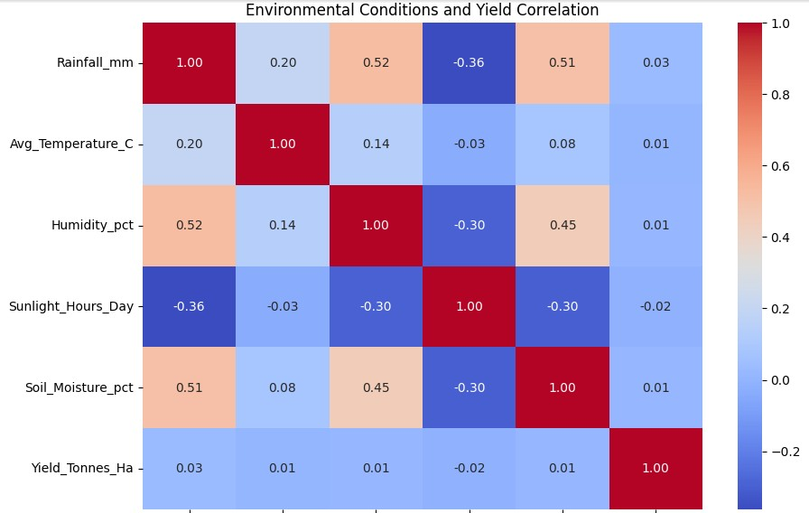
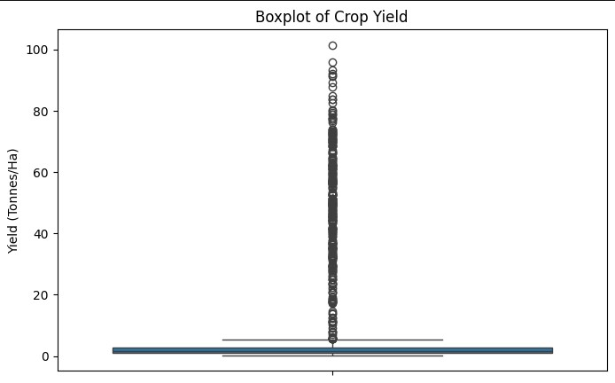
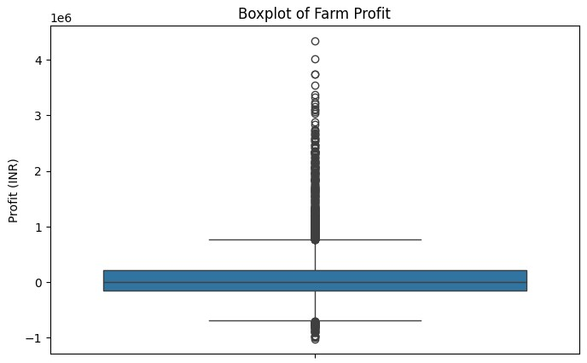
RESULTS

Slide 11
Future scope
Real-time agricultural monitoring using live weather and soil data.
Predictive analytics to forecast crop yield and seasonal performance.
Crop recommendation system based on soil, climate and seasonal conditions
Smart irrigation to optimize water usage and improve water efficiency.
Disease and pest prediction using environmental and historical data.
Interactive dashboard for farmers and agricultural departments.
Regional comparison and planning to identify high-performing areas.
Integration with IoT sensors for real-time farm data collection.

Slide 12
GitHub Link
https://github.com/Khushi07708/Seasonal-agriculture-performance-analysis

Slide 13

VOIS Course completion certificate -
Course name- Data Visualization

Slide 14
Thank you
.
.

